Slide 1

WIPRO NGA Program – Datacenter Batch
Capstone Project Presentation – 06 April 2024
Project Title Here - Capstone Project
Presented by - Arshad P
www.rpsconsulting.in

Slide 2

PROJECT TASK 1
Create a domain controller using domain name as name.training and create a shared NFS folder (c:\sharables) on domain controller machine with read-only permissions and access this folder on the member machine.
- Use VMWare workstation 17 or above to create a windows server 2016 as domain controller with a custom LAN Segment names as “Wipro-network”.
- Provide static IP as 192.168.10.10/24 with loopback DNS address & perform post-installation configuration.
- Install the required role and promote the server to domain controller.
- On DC, create a group using name “dcadmins” and add 2 users in it with the ‘domain admins’ permissions. - Install another windows server 2016 (as GUI) with the name “Member01” and domain join this member to domain controller & verify.
- Create a new directory as “c:\sharable” on domain controller with read-only & list permission to a group called “dcadmins” and verify the access from the “Member01” machine.
- Create few files under “c:\sharable” and try accessing and modifying them on the member machine using the users created under “dcadmin” group.
2024 - RPS Consulting all rights reserved

Slide 3
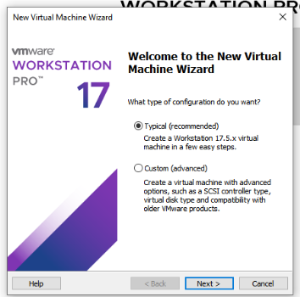
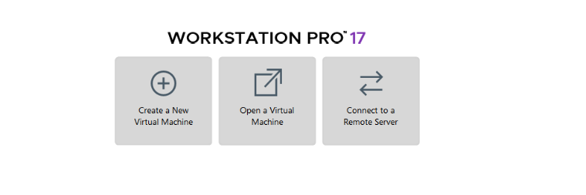
Installing Windows Server 2016
Steps :
Open VMWARE
Click on Create a New Virtual Machine
Choose Typical and click next
2024 - RPS Consulting all rights reserved

Slide 4
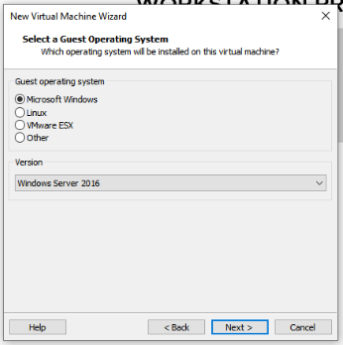
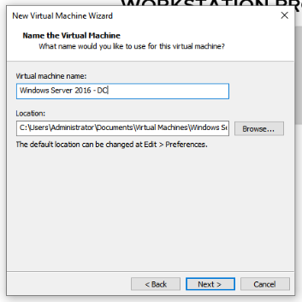
Select microsoft windows
Choose version "windows server 2016
Enter virtual machine name
Browse the destination location
2024 - RPS Consulting all rights reserved

Slide 5
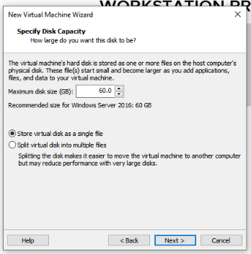
Type the disk space in Gb
Select "store virtual disk as a single file
We need minimum 60GB space to install windows server 2016
2024 - RPS Consulting all rights reserved

Slide 6
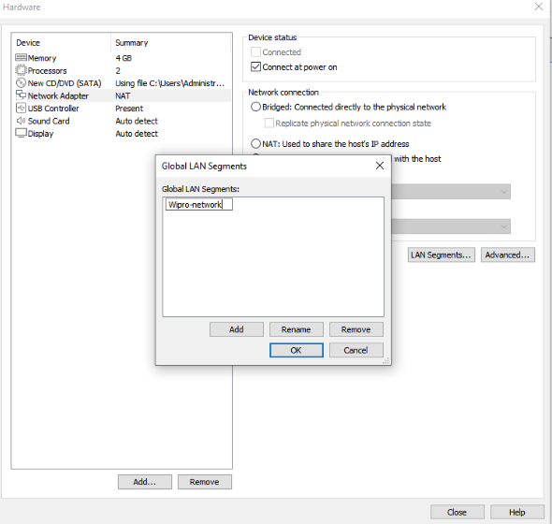
Select 4GB minimum memory.
Configure processors
Browse the iso file
Change network connection to LAN segment
Here creating new LAN segment named "Wipro-network"
LAN segment is to create isolated network environment within a virtual infrastructure
2024 - RPS Consulting all rights reserved

Slide 7
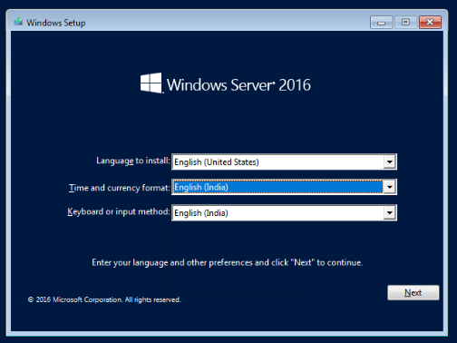
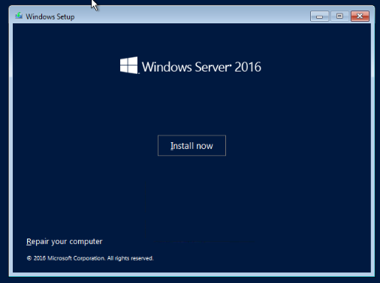
2024 - RPS Consulting all rights reserved

Slide 8
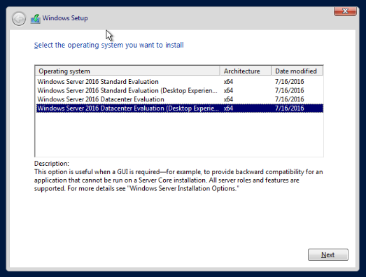
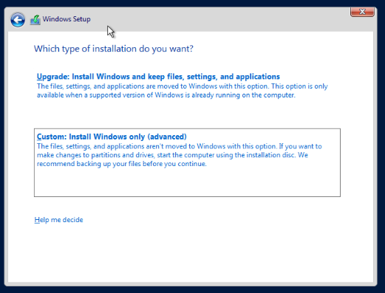
2024 - RPS Consulting all rights reserved

Slide 9
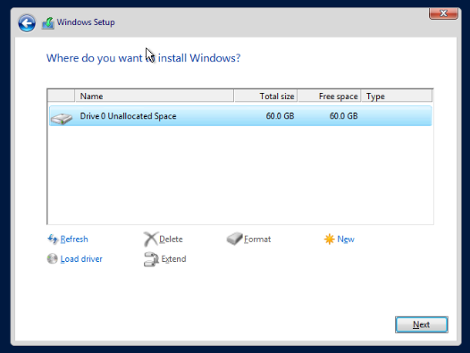
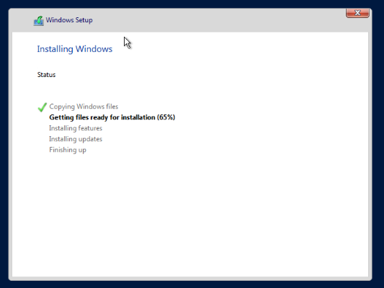
2024 - RPS Consulting all rights reserved

Slide 10
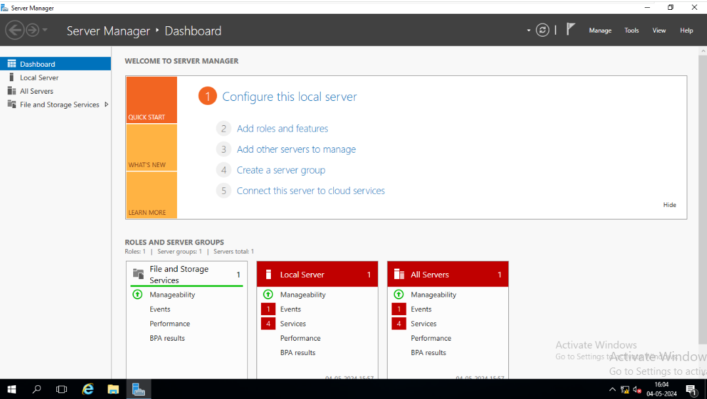
Windows server 2016 - installed
2024 - RPS Consulting all rights reserved

Slide 11
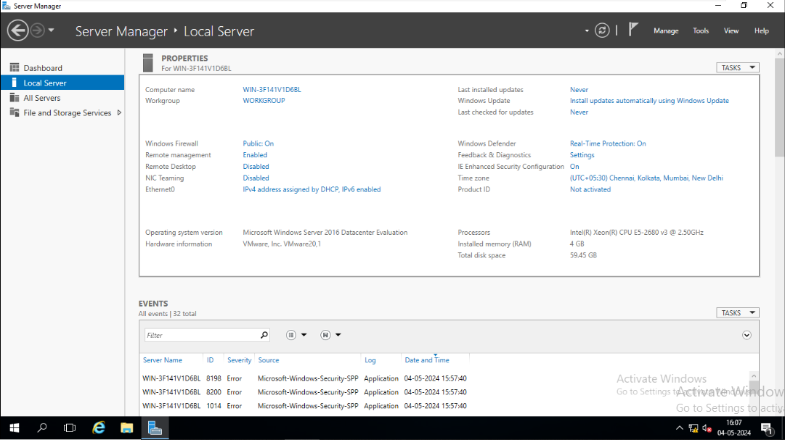
POST-INSTALLATION CONFIGURATION
2024 - RPS Consulting all rights reserved

Slide 12
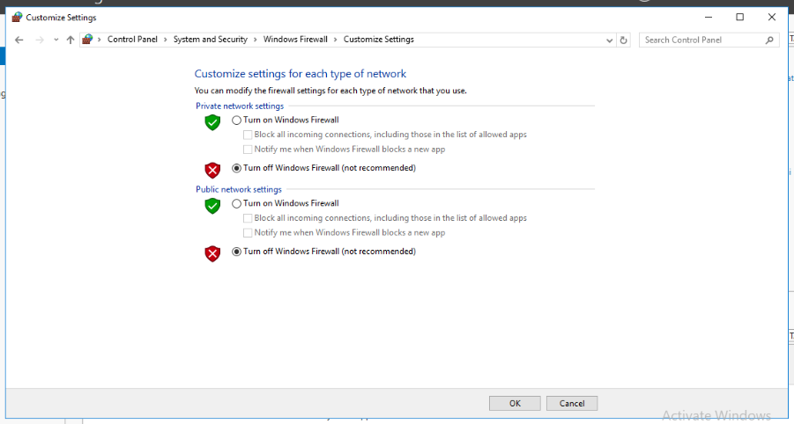
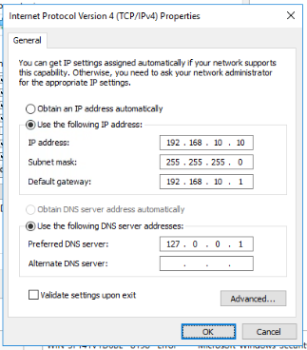
Turn off firewall
Configure IP Address
2024 - RPS Consulting all rights reserved

Slide 13
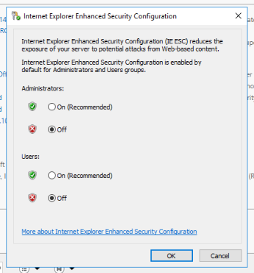
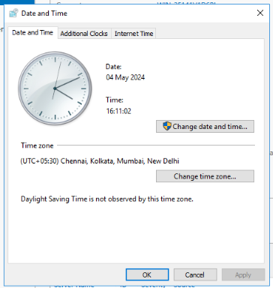
TURN OFF IE
SET TIME ZONE
2024 - RPS Consulting all rights reserved

Slide 14
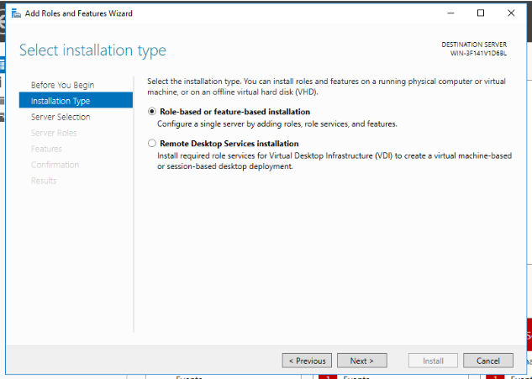
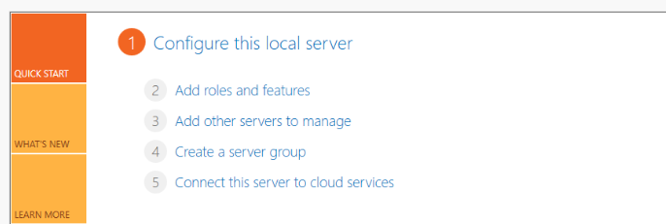
INSTALLING ADDS
SELECT "ADD ROLES AND FEATURES"
CHOOSE "ROLE BASED OR FEATURE-BASED INSTALLATION
2024 - RPS Consulting all rights reserved

Slide 15
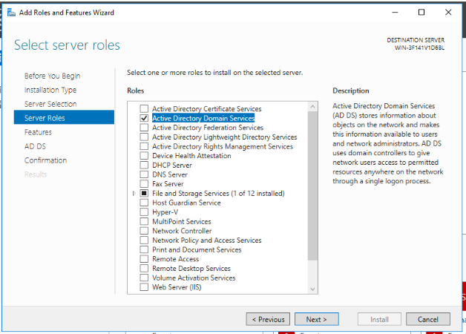
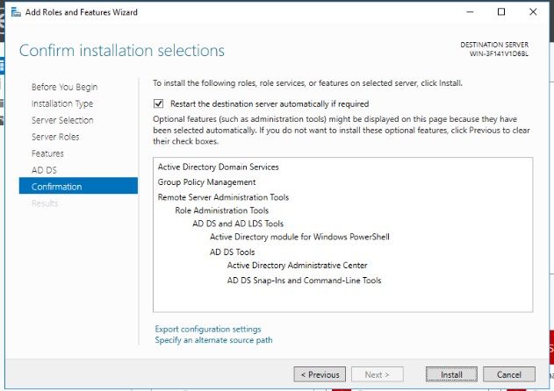
SELECT "ACTIVE DIRECTORY DOMAIN SERVICE
AND CLICK ADD FEATURES
CLICK INSTALL
2024 - RPS Consulting all rights reserved

Slide 16
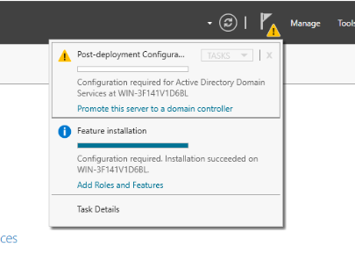
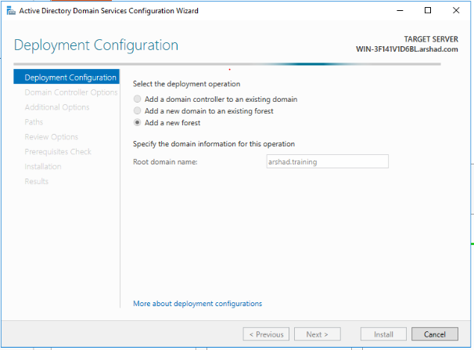
Click "promote this server to a domain controller"
Select "Add a new forest"
Enter Root domain name as "arshad.training"
2024 - RPS Consulting all rights reserved

Slide 17
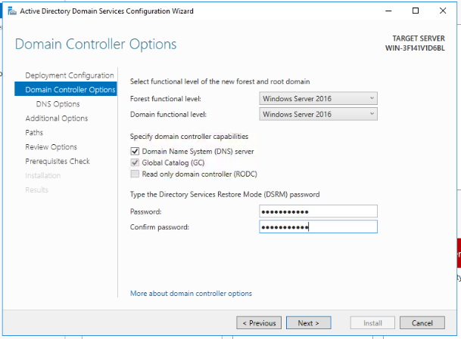
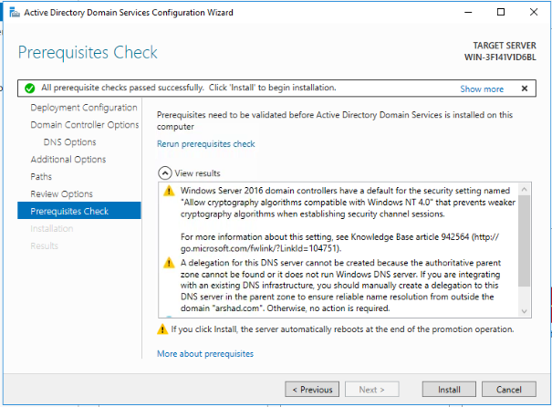
Enter DSRM Password
Used to access DC in case of any failure
Install
2024 - RPS Consulting all rights reserved

Slide 18
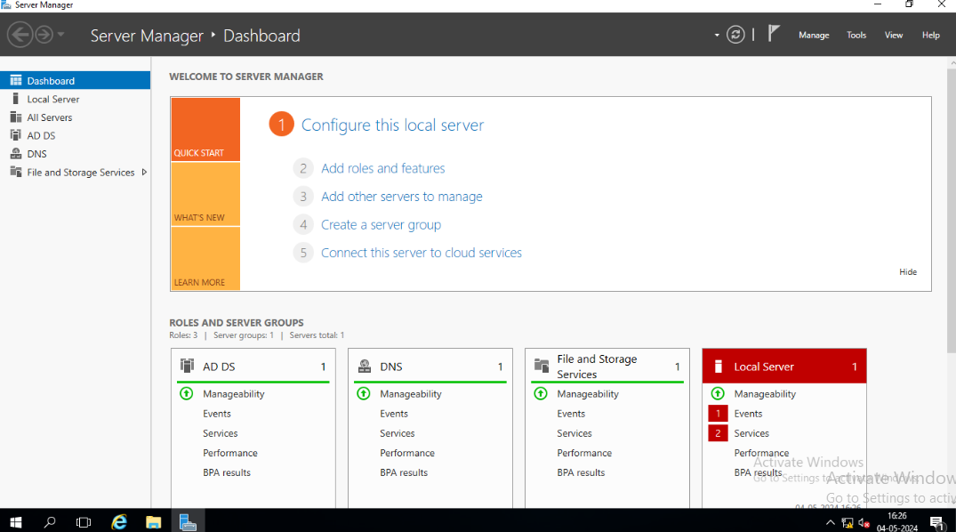
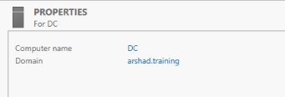
Now Server is Domain Controller
2024 - RPS Consulting all rights reserved

Slide 19
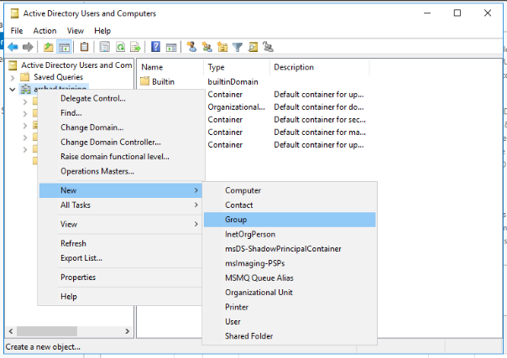
Create a group under DC
Click Tools
Active Directory Users and Computers
Right click on domain name
Click New
Select Group
2024 - RPS Consulting all rights reserved

Slide 20
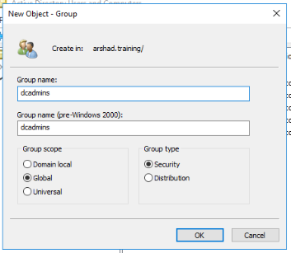
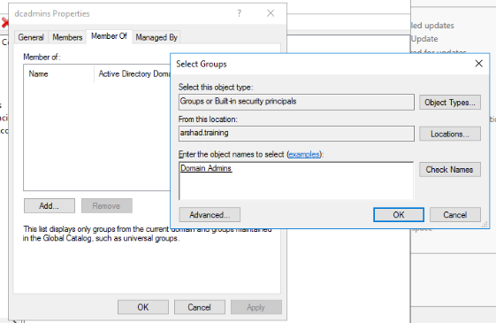
Create group named "dcadmins"
Right click group – click properties
Select member of
Add "domain admins"
2024 - RPS Consulting all rights reserved

Slide 21
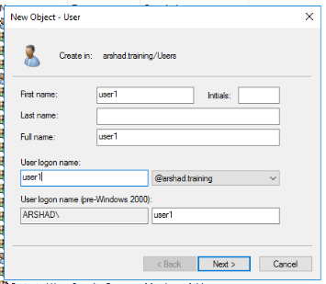
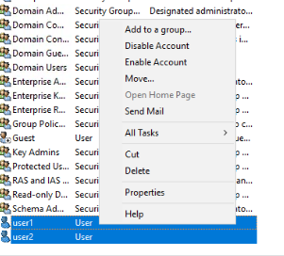
Create 2 users named "user1" and "user2"
Select both users and right click – select "Add to a group"
2024 - RPS Consulting all rights reserved

Slide 22
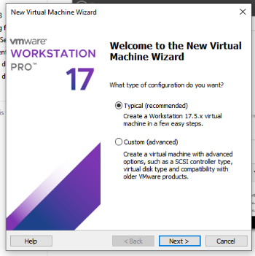
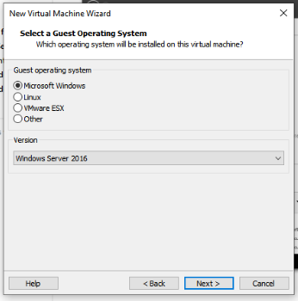
Installation of member01 machine ( windows server 2016 )
2024 - RPS Consulting all rights reserved

Slide 23
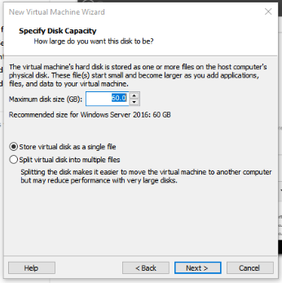
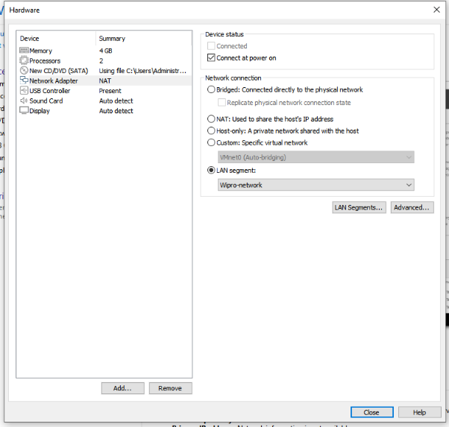
Change network connection to LAN Segment that we already created for DC machine named "Wipro-network"
2024 - RPS Consulting all rights reserved

Slide 24
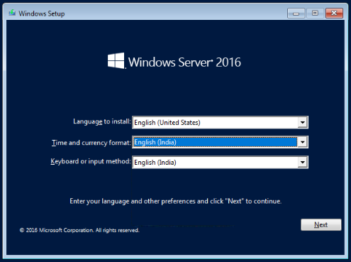
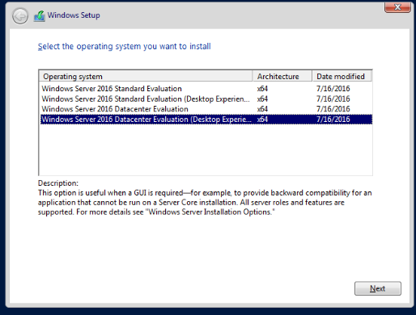
2024 - RPS Consulting all rights reserved

Slide 25
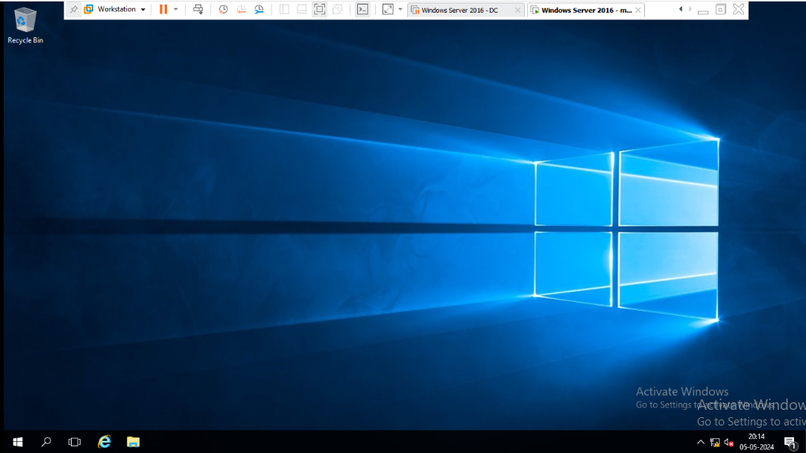
After installation , Open Server Manager --> Go to Local Server
2024 - RPS Consulting all rights reserved

Slide 26
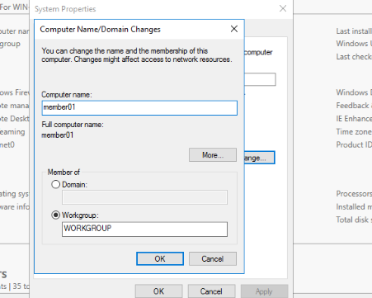
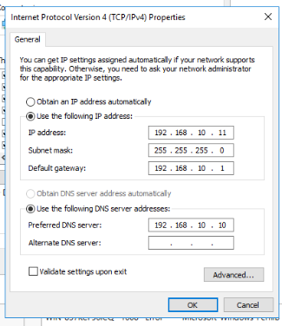
POST-INSTALLATION CONFIGURATION
Change Computer name to "member01"
DNS is DC ip address
2024 - RPS Consulting all rights reserved

Slide 27
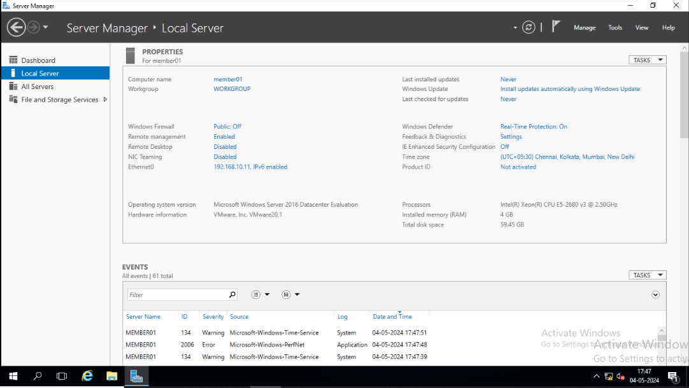
Turn off firewall , IE , and set Time Zone
2024 - RPS Consulting all rights reserved

Slide 28
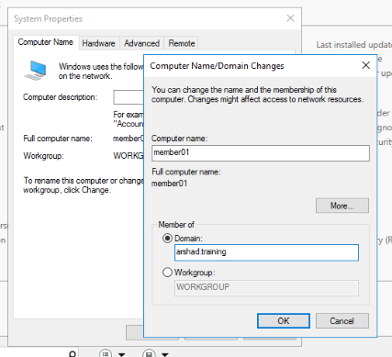
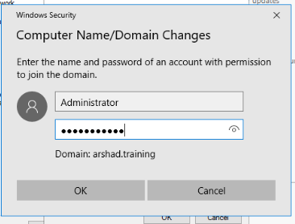
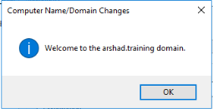
Domain join
2024 - RPS Consulting all rights reserved

Slide 29
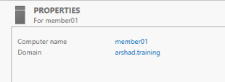
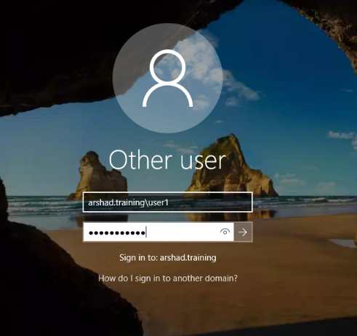
Now member01 machine is domain joined
Switch user and login with DC's user that are under the group "dcadmins"
Here login with user1
2024 - RPS Consulting all rights reserved

Slide 30
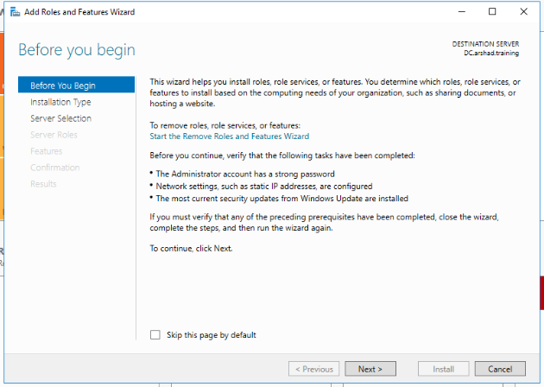
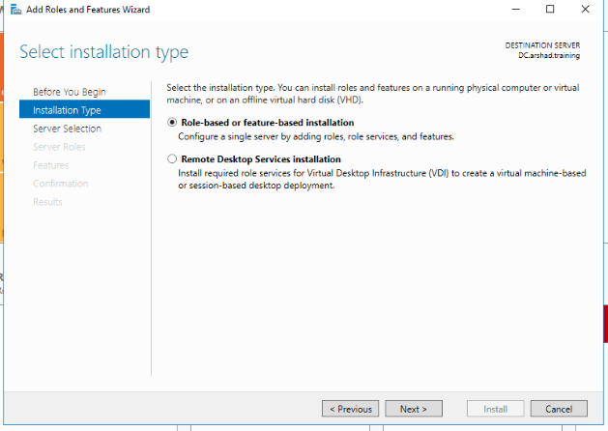
Configure NFS SERVER in DC
2024 - RPS Consulting all rights reserved

Slide 31


2024 - RPS Consulting all rights reserved

Slide 32


After completing the installation .
Select "File and storage services " in Server Manager
2024 - RPS Consulting all rights reserved

Slide 33


Also created a folder named "sharable" under C drive in DC machine
Click Shares ,then click Tasks . And then select New Share
2024 - RPS Consulting all rights reserved

Slide 34


Select NFS Share - Quick
Click "sharable" folder
2024 - RPS Consulting all rights reserved

Slide 35


2024 - RPS Consulting all rights reserved

Slide 36


Check Authentication
Set Permission
2024 - RPS Consulting all rights reserved

Slide 37


Click customize permission
Click Add and enter group name "dcadmins" and set permission
2024 - RPS Consulting all rights reserved

Slide 38


Here add group name
Then,
Set permission "read and list folders"
2024 - RPS Consulting all rights reserved

Slide 39

NFS sharing is done .
DC:/sharable is Remote path
2024 - RPS Consulting all rights reserved

Slide 40


Install NFS Client on Member01 machine
2024 - RPS Consulting all rights reserved

Slide 41


Select CLIENT FOR NFS and Install
2024 - RPS Consulting all rights reserved

Slide 42


Access the shared folder from member01
Or Mount using CMD
Click on "Map network drive"
2024 - RPS Consulting all rights reserved

Slide 43

Enter remote path here and Click Finish button
2024 - RPS Consulting all rights reserved

Slide 44

Here , while trying delete the file "Created_dc_2" that was created under sharable folder from DC machine .It shows Denied .
2024 - RPS Consulting all rights reserved

Slide 45
PROJECT TASK 1 COMPLETED
2024 - RPS Consulting all rights reserved

Slide 46
PROJECT TASK 2
Install CentOS 7 server (after installation GUI must be present).
Attach 3 disks of 5GB each & create 2 LVMs from these disks of 7GB (/lvm1) and 8GB (/lvm2) with XFS and EXT4 file systems respectively and verify.
Install the following RPM packages using the package manager of your choice using single command.
- VSFTPD
- PHP
- System-Config-Kickstart
- finger.
Start “YES” process and use TOP command to kill this process.
2024 - RPS Consulting all rights reserved

Slide 47



Installing Centos 7 Server (Gui) via Text-mode
2024 - RPS Consulting all rights reserved

Slide 48


30GB diskspace
And browse the iso file
2024 - RPS Consulting all rights reserved

Slide 49


Power on the virtual machine
When installation screen appears click "Tab" key and type "text" instead of "quiet" and Enter
Then installation will start on text-mode
2024 - RPS Consulting all rights reserved

Slide 50


Here we need to configure language , time zone , installation source , software selection , installation destination , root password and user creation one by one
2024 - RPS Consulting all rights reserved

Slide 51


Type 1 for language
And type 16 for English
Type 9 for Indian Time zone
And select region
2024 - RPS Consulting all rights reserved

Slide 52


Type 3 for installation source
Then , Type 1 for CD/DVD
Type 4 for software selection
Type 7 for Server with GUI
2024 - RPS Consulting all rights reserved

Slide 53


Type 5 for installation destination
And type 1 for choose destination
Then type 2 for Use all space
2024 - RPS Consulting all rights reserved

Slide 54


Type 8 and Set root password
2024 - RPS Consulting all rights reserved

Slide 55


User creation and set password
2024 - RPS Consulting all rights reserved

Slide 56


Type "b" for begin the installation
2024 - RPS Consulting all rights reserved

Slide 57


2024 - RPS Consulting all rights reserved

Slide 58


Login with root and password
Type "init 5" for switch to GUI
2024 - RPS Consulting all rights reserved

Slide 59


Type this command on terminal to make server gui by default
2024 - RPS Consulting all rights reserved

Slide 60


Configuring ip address , hostname using nmtui
Nmtui – Network Manager Text User Interface
Select "set system hostname "
2024 - RPS Consulting all rights reserved

Slide 61


Enter the hostname and click OK
Click "edit a connection" for ip configuration
2024 - RPS Consulting all rights reserved

Slide 62


Make ipv4 to manual and enter the ip address and click ok
2024 - RPS Consulting all rights reserved

Slide 63

Here , The ip address and hostname is changed
2024 - RPS Consulting all rights reserved

Slide 64


Next Step : attack three 5GB hdd
2024 - RPS Consulting all rights reserved

Slide 65

2024 - RPS Consulting all rights reserved

Slide 66


Creating partitions
/dev/sdb
/dev/sdc
2024 - RPS Consulting all rights reserved

Slide 67


/dev/sdd
Partitions created
2024 - RPS Consulting all rights reserved

Slide 68



Create physical volume
Create logical volume
Create volume group
Here created 7GB for lv1 and 8GB for lv2
2024 - RPS Consulting all rights reserved

Slide 69

Create partition for new logical volumes
Xfs for lv1
Ext4 for lv2
2024 - RPS Consulting all rights reserved

Slide 70

2024 - RPS Consulting all rights reserved

Slide 71


Create mount point for lv1 (/lvm1) and lv2 (/lvm2)
Edit the fstab file using vi editor
/etc/fstab file specifies the device , mount point , file system type and other parameters
Add both lv1 and lv2 into it , then save and exit
2024 - RPS Consulting all rights reserved

Slide 72

To mount all file system listed on fstab file
2024 - RPS Consulting all rights reserved

Slide 73

lv1(/lvm1) and lv2 (/lvm2) is created
2024 - RPS Consulting all rights reserved

Slide 74


Step 3 : Install the rpm packages using yum .
-vsftpd
-php
-system-config-kickstart
-finger
To do , we need to create a mount point for centos disk . Inside centos disk there is a directory called “Packages” . Packages contains .rpm packages. We need to from there using yum .
Creating mount point for centos disk
Then mount cdrom to that particular directory that we created
2024 - RPS Consulting all rights reserved

Slide 75


We need to edit yum repo using yum.repos.d directory.
/etc/yum.repos.d is used for find configuration files for software in linux systems thst use yum.
Here Base.repo is default repository. Edit Centos-Base.repo using vi editor
2024 - RPS Consulting all rights reserved

Slide 76

Here mention the base url , that was our mount point of cdrom that contains rpm packages.
2024 - RPS Consulting all rights reserved

Slide 77

#Yum clean all. Is used for clearing local cache , and force yum to download latest package information from repo next time.
2024 - RPS Consulting all rights reserved

Slide 78

Open the path of where rpm packages are located and then , Install using yum
2024 - RPS Consulting all rights reserved

Slide 79

2024 - RPS Consulting all rights reserved

Slide 80

2024 - RPS Consulting all rights reserved

Slide 81

Installed those 4 packages
2024 - RPS Consulting all rights reserved

Slide 82


Step 4 : Start Yes process and kill process using top
2024 - RPS Consulting all rights reserved

Slide 83

#top
2024 - RPS Consulting all rights reserved

Slide 84


Press k and enter process id of "yes" then press enter
Type 9 and enter for killing the process
2024 - RPS Consulting all rights reserved

Slide 85

Process killed
2024 - RPS Consulting all rights reserved

Slide 86
PROJECT TASK 2 COMPLETED
2024 - RPS Consulting all rights reserved

Slide 87
PROJECT TASK 3
Use MySQL workbench and create an employee database. Create a table empdetails (emp_id, Name, Age, Salary, Position). Create another table emplocation (emp_id, location). Create primary key & foreign key in the tables accordingly and perform CRUD operation on the table. Use joins to display “emp_id, Name, Age, Salary, location” using primary key & foreign key concept.
Setup: -
-Use existing MySQL workbench Setup.
- Create a database
- Create 2 tables in it & verify.
- Insert data (according to your wish) & verify.
- Display (emp_id, Name, Age, Salary, location) as a single output.
2024 - RPS Consulting all rights reserved

Slide 88

Open MySQL Workbench
2024 - RPS Consulting all rights reserved

Slide 89

2024 - RPS Consulting all rights reserved

Slide 90

Create a database "employee"
2024 - RPS Consulting all rights reserved

Slide 91

Use the database and create a table named “empdetails”
2024 - RPS Consulting all rights reserved

Slide 92

create another table named emplocation
2024 - RPS Consulting all rights reserved

Slide 93

Insert data into table empdetails
2024 - RPS Consulting all rights reserved

Slide 94

insert data into table emplocation
2024 - RPS Consulting all rights reserved

Slide 95

CRUD OPERATIONS
2024 - RPS Consulting all rights reserved

Slide 96

2024 - RPS Consulting all rights reserved

Slide 97

JOIN TABLE
2024 - RPS Consulting all rights reserved

Slide 98

JOINED
PROJECT TASK 3 COMPLETED
2024 - RPS Consulting all rights reserved

Slide 99
THANK YOU !
2024 - RPS Consulting all rights reserved

